Slide 1

Finance Project 2
By: Gavin Bowen

Slide 2
Project Tasks
Create a way for three asset classes to be chosen and chart their cumulative return over a specified date
Calculate the metrics of a 60/40 portfolio
Find a way to rebalance a 60/40 portfolio and defend against portfolio drift
Create A portfolio that can be used with Excel’s solver tool to effectively optimize
Calculate the max drawdown for the chosen asset class over a desired period and include the drawdown’s start and end date

Slide 3
Cumulative Return Data
Cumulative Return
MSCI Emerging Markets | S&P 500 | US Aggregate Bond Index
105.650% | 21.724% | 43.925%

Slide 4
Portfolio Skills Improvement
Total Return | =(H6730-H4)/H4
Annualized Return | =((H6730/H4))^(1/18)-1
Annualized Volatility | =STDEV.S(FILTER(I5:I6730,I5:I6730<>0))*SQRT(252)
Risk-adjusted Return | =L3/L4
Rebalance Frequency
Annual | 1
Total Return | 219.15%
Annualized Return | 6.66%
Annualized Volatility | 9.20%
Risk-adjusted Return | 0.72
Rebalance Frequency
Quarterly | 4
Total Return | 211.99%
Annualized Return | 6.53%
Annualized Volatility | 9.37%
Risk-adjusted Return | 0.70
Rebalance Frequency
Semi-Annual | 2
Total Return | 216.97%
Annualized Return | 6.62%
Annualized Volatility | 9.22%
Risk-adjusted Return | 0.72
Rebalance Frequency
Monthly | 12
Total Return | 185.01%
Annualized Return | 5.99%
Annualized Volatility | 9.37%
Risk-adjusted Return | 0.64

Slide 5
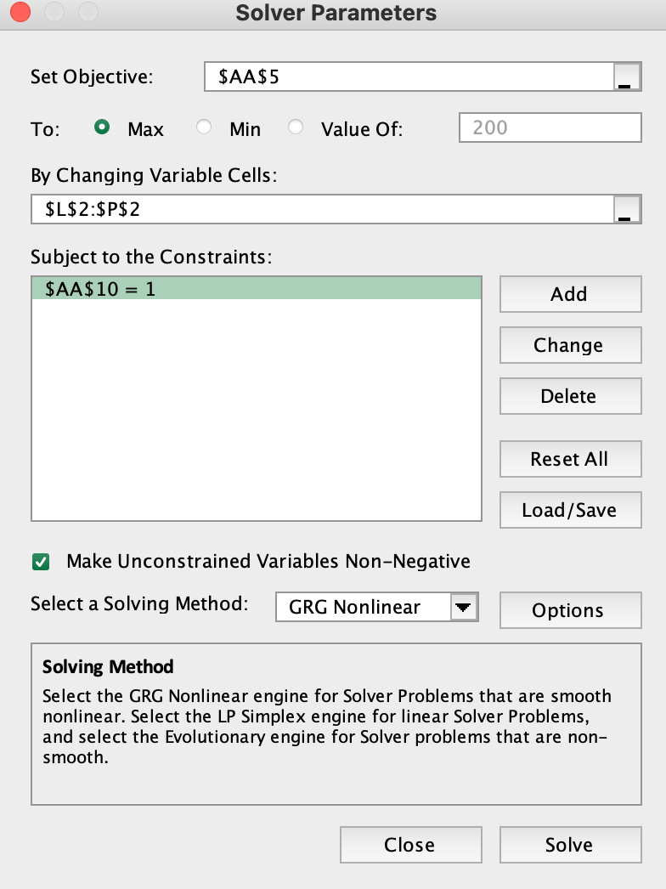
Maximize Return
Rebalance Frequency
Annual | 1
0.00% | 0.00% | 0.00% | 0.00% | 100.00%
S&P 500 | US Aggregate Bond Index | Commodity Index | MSCI Emerging Markets | NASDAQ-100
Total Return | 515.62%
Annualized Return | 10.62%
Annualized Volatility | 18.39%
Risk-adjusted Return | 0.58

Slide 6
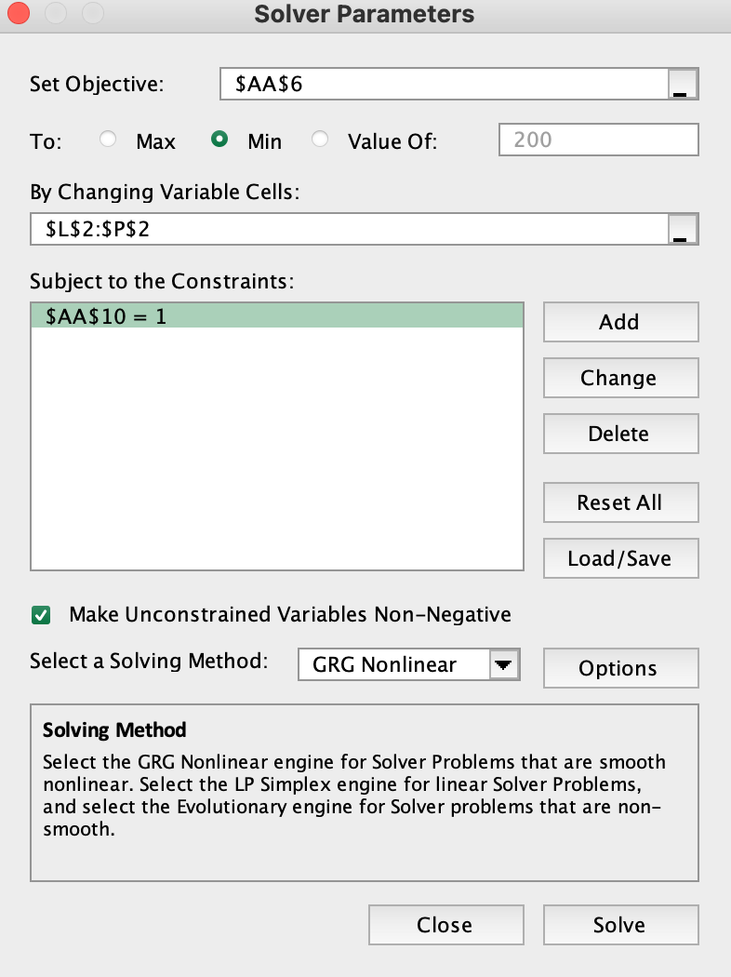
Minimize Volatility
Rebalance Frequency
Monthly | 12
5.11% | 88.49% | 5.10% | 1.29% | 0.00%
S&P 500 | US Aggregate Bond Index | Commodity Index | MSCI Emerging Markets | NASDAQ-100
Total Return | 71.43%
Annualized Return | 3.04%
Annualized Volatility | 3.18%
Risk-adjusted Return | 0.96

Slide 7
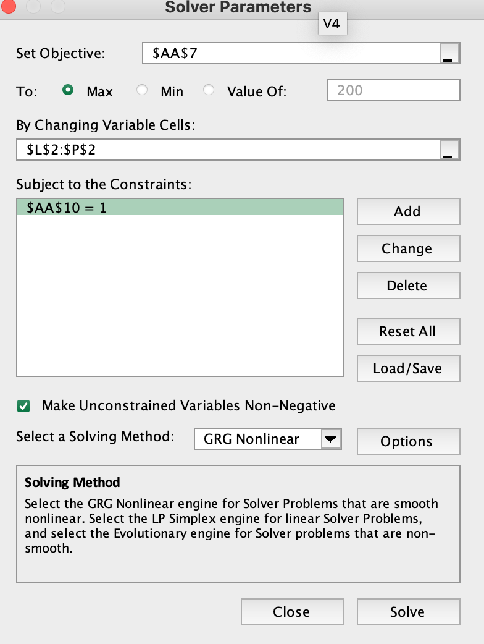
Maximize Risk Return
Rebalance Frequency
Annual | 1
0.00% | 82.55% | 0.00% | 2.28% | 15.17%
S&P 500 | US Aggregate Bond Index | Commodity Index | MSCI Emerging Markets | NASDAQ-100
Total Return | 129.95%
Annualized Return | 4.73%
Annualized Volatility | 3.85%
Risk-adjusted Return | 1.23

Slide 8

Observations
Generally, annual periods created higher returns
Max return was 100% NASDAQ-100
US Aggregate Bond Index was 3.49% volatility by itself while portfolio was 3.18%
The risk adjusted returns of the 60/40 were about the same as the five-asset class portfolio, however, the five-asset class had to achieve overall lower metrics in order to achieve this

Slide 9
Maximum Drawdown
Start Date | 5/31/19
End Date | 4/30/24
Asset Class | MSCI Emerging Markets
Max Drawdown | -38.59%
Max Drawdown Start | 2/17/21
Max Drawdown End | 10/24/22

Slide 10
Learned Financial Concepts
Cumulative return comparison over different time periods (important to understand economic trends)
Portfolio return, volatility, and risk-adjusted return
Portfolio drift
Max Drawdown
Portfolio Optimization
Portfolio rebalancing

Slide 11
Learned Excel Functionality
FILTER Excel Generated Function
MIN and MAX Excel Generated Functions
Data Validation Tool
INDEX Excel Generated Function
MATCH Excel Generated Function
Dynamic Graphs and Scatterplots
Cell Referencing
Using fn+f4 to make excel data ranges dynamic or static
Workbook Formatting
Interactive Chart Titles and TEXT Excel Generated Function
MAXIFS Excel Generated Function
Excel's "Solver" tool
VLOOKUP Excel Generated Function
YEAR, MONTH, and DAY Excel Generated Functions
ISERROR, ISNUMBER, and IFERROR Excel Generated Functions
IF and AND Excel Generated Functions
Graph Formatting
LN and STDEV.S Excel Generated Functions

